Slide 1


NCAA Bracket Predictor Sprint 4
Nate Lang, John Hattas, Kevin Brosam, Alex Berkhout, Matt Petter

Slide 2
Sprint 4 Overview
Main Goal:
Polish Website
Produce better algorithm

Slide 3
User Story Example
John wants to use the website easily, from both his desktop and his mobile device. He wants to select multiple indicators and see what percentage of the bracket he got right for previous years. He also wants to see which picks the prediction got right and wrong. He wants to try multiple different ones and see what his high score is. When it is all said and done he wants to close out of the website with ease.

Slide 4
Tests

Slide 5

PRODUCT DEMO

Slide 6
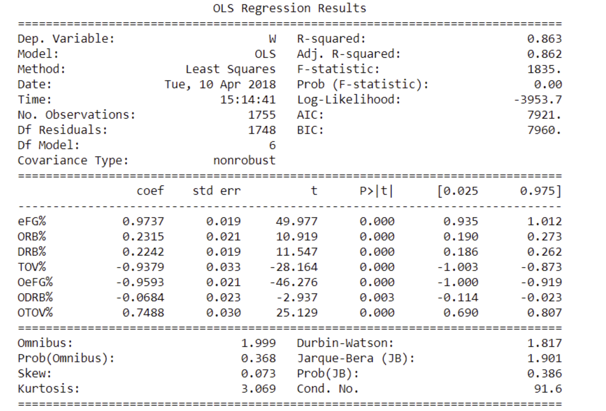
Statistical Methods

Slide 7
Backlogs
Sprint Backlog
Product Backlog
Task | Priority [1-10 (1 being lowest)] | Completed(Y/N)
% added to website | 8 | Y
Right and wrong picks added to website, with colors | 9 | Y
Weighting feature working correctly | 8 | Y
Add 2018 | 10 | Y
Reset button | 5 | Y
More indicators | 5 | Y
Normalize data, make opponent stats negative | 10 | Y
Display weighing formula | 4 | Y
Test with another group | 10 | Y
High score | 3 | Y
Task | Priority [1-10 (1 being lowest)] | Completed(Y/N)
Develop an algorithm that predicts future tournament results | 1 | N
Integrate more advanced statistics | 7 | Y
Create picture of the bracket with appropriate teams | 7 | Y
Collect Data | 10 | Y
Have a basic working model | 10 | Y
Potentially display through HTML | 1 | Y
Update for 2018 tournament | 3 | Y
Display data in charts and tables | 5 | Y
Create User Interface | 4 | Y
Host website | 9 | Y
Create working website model | 8 | Y
Merge website and python code to work together effectively | 8 | Y

Slide 8
Sprint Retrospective

